Slide 1
Big Mountain Resort Report - Ticket Pricing Predictions
Data driven answers
Edward Sung

Slide 2
Where do we focus? Who do we talk to?
Our focus needs to be on our ticket sales and pricing. We need to adjust prices to capitalize more of what the resort has to offer to its customers.
But we must take into consideration potential customer backlash due to increased ticket prices, as well as the competition from other resorts following suite in ticket price adjustments.
I am here to provide you the resources and information, but you hold the power in deciding Big Mountain Resort’s future and direction.

Slide 3
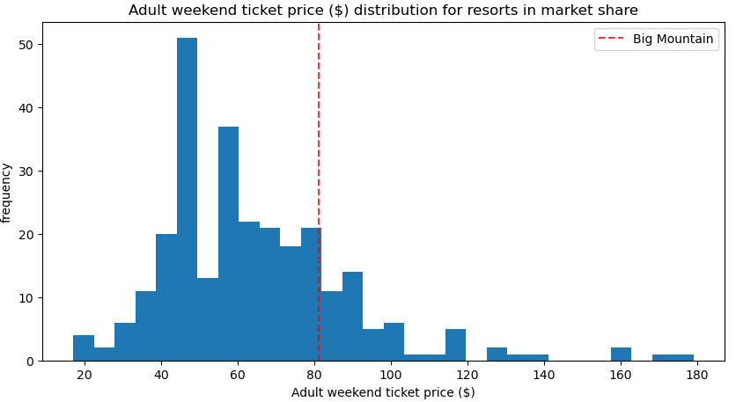
How do we use more of the market data to drive our ticket pricing?
Big Mountain Resort tickets are currently being charged at a premium just above the market average.
This does not take into the considerations the variety of facilities and customer accommodations the resort has to offer.
Business model needs to be adjusted to increase revenue to offset the operational cost of a new lift by $1,540,000 by end of the season to justify the installation.

Slide 4
What are the steps we need to take now?
Big Mountain Resort is currently priced at $81.
My model predicts that the price can potentially be $95.87, an 18% increase in revenue.
Big Mountain Resort have the facilities to provide more than just a premium just above the market.

Slide 5
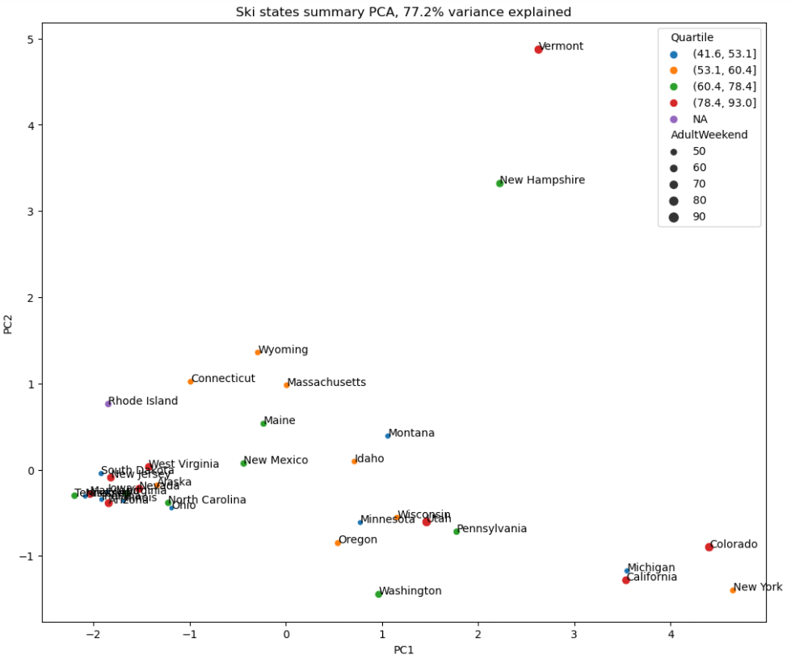
What can we assume about the data set as a whole?
PCA summary of 77.2% of the variance explained for the ski resorts in their respective states show that there is no significant outliers to remove from consideration.
Although New Hampshire and Vermont is large in PC2, they are offset by their relatively small PC1. Same with Colorado and New York.
This means we can consider all the data from all the states to support the prediction for our resort in Montana.

Slide 6
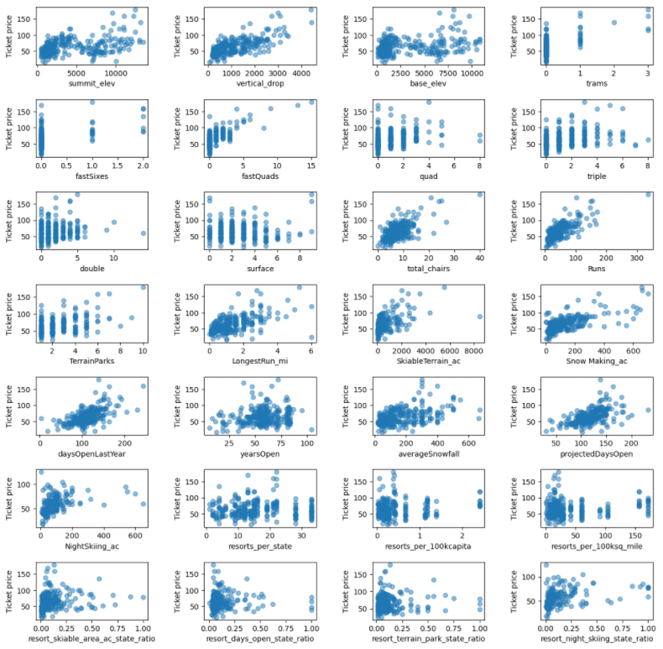
Data at a glance
A quick look at the data set with Ticket Price as the dependent variable, there are trends that easily stand out.
With Big Mountain Resort ranking near the top for many of these features, this positive correlation shows we should be charging a higher ticket price.

Slide 7
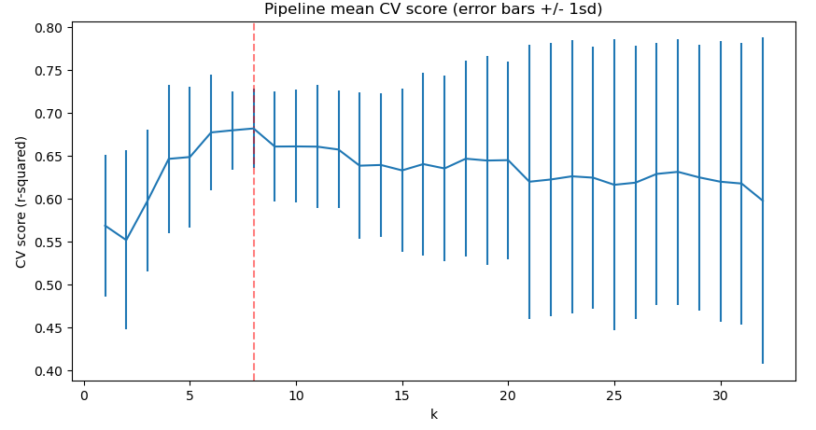
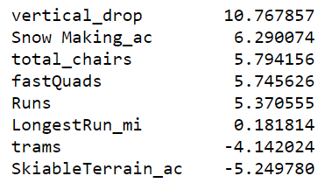
Linear Regression Model
Linear regression model has identified 8 different combination of features to provide the best price prediction.
Cross validation shows that moving past the marked 8 k features show decline and larger variations.
The listed Features and
their coefficient impact:

Slide 8
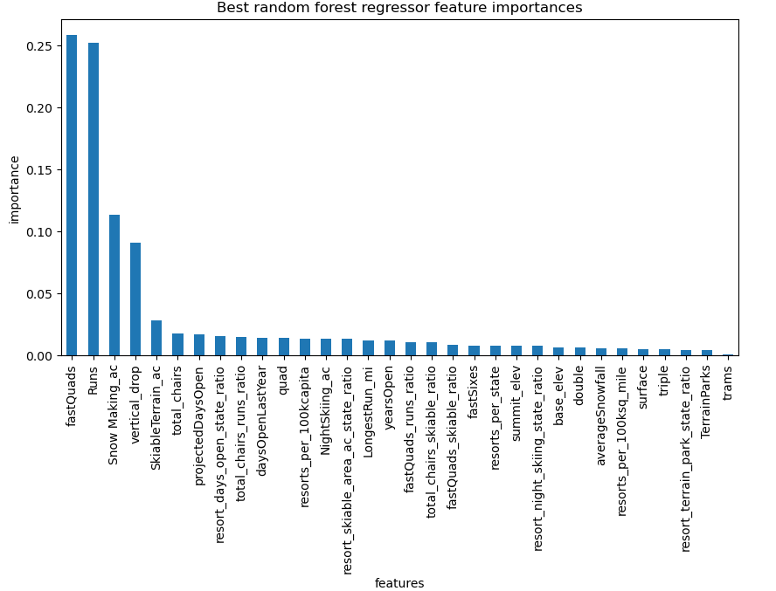
Random Forest Regressor Model
A secondary model for comparison using random forest regressor shows top 4 features that are also in the linear regression model.
fastQuads, Runs
Snow making_ac
vertical_drop

Slide 9
Business Scenarios
The linear regression model shows more utility, given its larger range of features compared to the random forest regressor.
This allows us to apply the linear model on the proposed 4 business decisions.
Permanently closing up to 10 of the least used runs. This doesn't impact any other resort statistics.
Increase the vertical drop by adding a run to a point 150 feet lower down, but requiring the installation of an additional chair lift to bring skiers back up, without additional snow making coverage.
Same as number 2, but adding 2 acres of snow making cover.
Increase the longest run by 0.2 mile to boast 3.5 miles length, but requiring an additional snow making coverage of 4 acre.

Slide 10
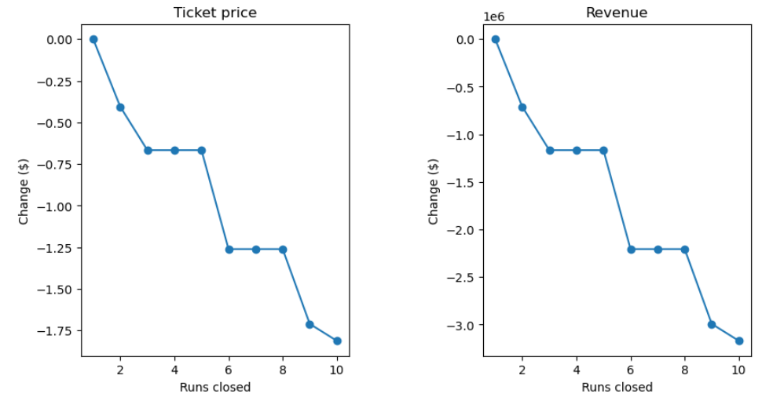
Summary
The model predicts that changing the variables listed in Scenarios 2 – 4 have very little to no impact on ticket pricing between them.
Scenario 1 show the most variability with closing down runs.
Shown in the graph:
Closing 1 – no impact
Closing 2 or 3 – negative price and revenue change
Closing 4 or 5 – little to no change with closing down 3
Closing 6 – significant drop (Not recommended)

Slide 11
Conclusion
Business decisions with the largest impact should be focused around closing down runs.
Following the graphical trend and monitoring closely of actual price and revenue change, runs should be closed to offset the operational cost of the new chair list.
Continued reduction of runs may be considered to reach financial goals.

